Slide 1

The Nelson Mandela African Institution of Science and Technology
Course Name: Research Methods and
Communication
Course Code: 6001
(Lecturer: Elizabeth Mkoba, PhD)
Learning Unit 3: Research Methodology

Slide 2
Read This Slowly by Jakewoodard
“The Universe responds to your frequency. It does not recognize your personal desires, wants or needs. It only understands the frequency in which you are vibrating at.
For example,
If you are vibrating in the frequency of fear, guilt or shame, you are going to attract things of similar vibration to support that frequency.
If you are vibrating in the frequency of love, joy and abundance, you are going to attract things to support that frequency.
It is like tuning into a radio station. You have to be tuned into the radio station you want to listen to just like you have to be tuned into energy you want to manifest in your life”.

Slide 3
LEARNING OUTCOMES
Students should be able to:
Explain research philosophies
Describe research strategies
Describe research methods
Describe time horizons.

Slide 4
LEARNING UNIT 2 ASSESSMENT CRITERIA
Students should be able to:
Understood research philosophies
Understood research strategies
Understood research methods
Understood time horizons.

Slide 5
Research Methodology
According to Kothari (2004), a research methodology is a systematic way of solving a research problem.
The connection between the research objectives and the research method should be evident.
It is one of the most important parts of a research proposal/dissertation.
A research methodology describes how the research is to be carried out.
The research philosophical assumptions guide the researcher in selecting the appropriate research approach.

Slide 6
Research Methods vs Research Methodology
Research methods includes all techniques and methods which have been taken for conducting research.
A research methodology describes how the research is to be carried out.

Slide 7
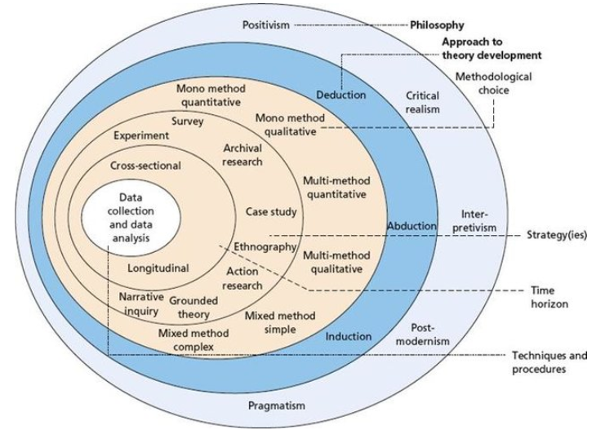
Research Onion by Saunders (2019)

Slide 8
1. Research Philosophy
Research philosophy provides a researcher with a guide in selecting an appropriate research approach.
Research philosophical assumptions are based on ontology, epistemology and human nature.
These assumptions are categorised into subjective and objective.

Slide 9

1. Research Philosophy …
There are a number of philosophical issues, relating to the questions of objectivity and subjectivity of a statement, judgement, information, point of view or anything else.
A statement is said to be objective when it is based on facts, and it can be proved easily and is impossible to deny.
Although in the absence of facts on a matter, then the statement becomes subjective, as the speaker presents his/her opinion, which is always biased.
Subjective perspective is based on personal feelings, likes, interest, dislikes, and the like.

Slide 10
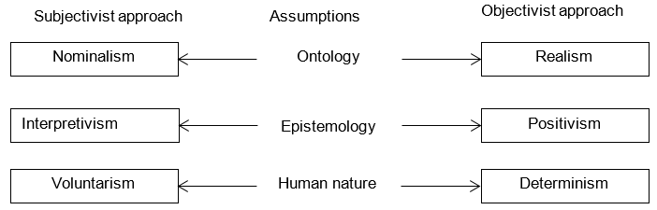
1. Research Philosophy …
Book: Burrell, G. & Morgan, G. (1979). Sociological paradigms and organisational analysis. London: Heinemann.
.

Slide 11
1. Research Philosophy …
Ontology: An ontological assumption is based on the nature of reality, and the underlying research philosophical assumptions are nominalism and realism (Burrell & Morgan, 1979).
The nominalists (subjectivists) believe that the social world is made up of nothing other than concepts, names and labels which are used to structure reality (Burrell & Morgan, 1979).
Realists (objectivists) believe that the real world has its own reality, and is made up of hard, tangible and relatively immutable (unable to be changed) structures.

Slide 12
1. Research Philosophy …
Epistemology: Assumptions about knowledge, and how it can be obtained and communicated to other human beings.
The underlying philosophical assumptions that guide the research are interpretivism and positivism.
Positivists believe that the social world exists externally and is viewed objectively, research is value-free and a researcher is independent, taking on the role of an objective analyst.
Positivist research involves formal propositions, quantifiable measures of variables, hypothesis testing and discovering causal relationships between variables through empirical observation and value-free research .

Slide 13
1. Research Philosophy …
Interpretivists believe that the world is socially constructed and subjective
The researcher is a part of what is observed and even actively collaborates, while research is driven by human interests and takes a broad view of a phenomenon to detect explanations beyond the current knowledge.
Interpretive research does not predefine dependent and independent variables.

Slide 14
1. Research Philosophy …
Human nature: These are research assumptions concerned with the relationship between human beings and their environment.
The underlying philosophical assumptions that guide the research are determinism and voluntarism.
Determinists believe that human actions are largely caused by external forces, pressures and structures that operate on individual, group, organisational or societal produced outcomes.

Slide 15
1. Research Philosophy …
Voluntarism is a subjective approach which views man to be completely autonomous.

Slide 16
1. Research Philosophy …
Which research philosophies are used in Information Systems Research?
In recent years, the philosophical assumptions applied in IS research are positivism, interpretivism and critical realism.
Most of the positivist research uses a quantitative research approach.
Most of the interpretivist research uses a qualitative research approach.
Critical realist research also uses a qualitative research approach.

Slide 17
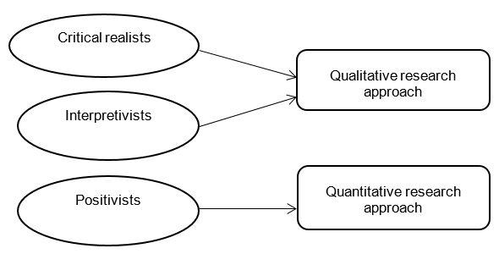
1. Research Philosophy …
Philosophical assumptions applied in Information Systems research:

Slide 18

1. Research Philosophy …
Important References
Guru in Information Systems Research Philosophies
Professor Michael D. Myers, University of Auckland,
New Zealand
https://scholar.google.com/citations?user=b-UjznkAAAAJ&hl=en
https://profiles.auckland.ac.nz/m-myers

Slide 19
2. Research Strategies
Research Strategies: The researcher cannot conduct research without establishing a research strategy. These strategies are:
Experiment,
Survey,
Case Study,
Ground theory,
Action Research,
Ethnography,
Archival Research

Slide 20
3. Research Methods
Concept:
There are three types of research methods: quantitative, qualitative and mixed methods. Select research method and provide justification of choosing it.
Example of multimethod:
Experiment + Questionnaire = Multimethod Quantitative
Interviews + Focus Group Discussion+ Delphi Method = Multimethod Qualitative
Note: Not necessary if you have used interview (qualitative method), observations, questionnaire (quantitative) are all to be a mixed method. Someone can use all the methods such as interview, observation, questionnaire as multimethod.

Slide 21
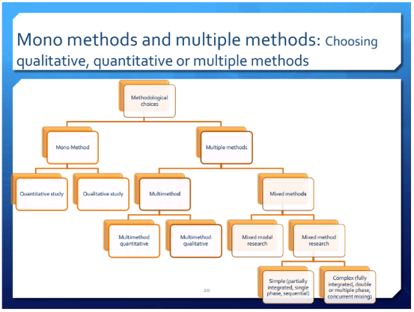
3. Research Methods …

Slide 22
3. Research Methods …
Qualitative Method:
Qualitative research is an inductive approach and exploratory in nature which aims at gaining an in-depth understanding of a phenomenon under enquiry.
The qualitative research approach was developed in the social sciences to enable researchers to study social and cultural phenomena.
Qualitative research method use interviews, focus group discussion, observations etc.
There are numerous research strategies applied in the qualitative research method such as case studies, ethnography, ground theory and action research.

Slide 23
3. Research Methods …
Quantitative Method:
The quantitative research approach involves measuring concepts which provide numeric values for statistical computation and hypothesis testing
The most common research strategies applied in the quantitative method are surveys and experiments.
Surveys provide a numeric description of trends, attitudes or opinions of a population by studying a sample of the population.
Surveys use questionnaires for data collection, and quantitative data analyzed using statistical methods.

Slide 24
3. Research Methods …
Mixed Methods:
Mixed methods use both the quantitative and qualitative approaches in combination to provide a better understanding of research problems than either approach alone.
There are three basic mixed methods designs:

Slide 25
3. Research Methods …
Convergence parallel mixed methods design
This is a form of mixed methods design in which both quantitative and qualitative data are collected concurrently and analysed separately.
A researcher then compares and merges the quantitative and qualitative sets of results.
The merged results are then interpreted to find out if the two datasets converge, diverge or are related to each other

Slide 26
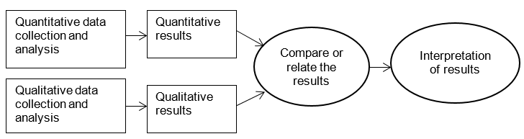
3. Research Methods …
Figure 1: Convergence parallel mixed methods design

Slide 27
3. Research Methods …
Explanatory sequential mixed methods design
This is a mixed methods design which starts with the collection and analysis of quantitative data.
It is then followed by designing a qualitative study based on the quantitative results.
The qualitative data are then collected and analysed.

Slide 28
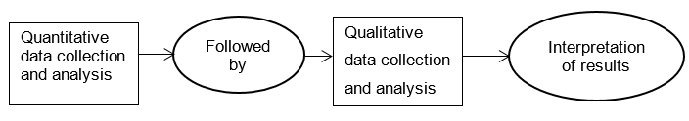
3. Research Methods …
Figure 2: Explanatory sequential mixed methods design

Slide 29
3. Research Methods …
3. Exploratory sequential mixed methods design
This is the reverse sequence from the explanatory sequential design.
In the exploratory sequential approach, the researcher starts with collecting and analysing qualitative data.
Then the qualitative results are used:
(i) to build an instrument that best fits the sample under study,
(ii) to identify appropriate instruments to use in the follow-up quantitative phase (iii) to specify variables that need to go into a follow-up quantitative study

Slide 30
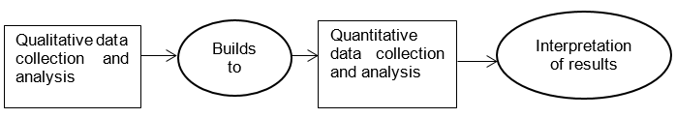
3. Research Methods …
Figure 3: Exploratory sequential mixed methods design

Slide 31
4. Time Horizons
1. Cross-sectional Research: This layer defines the time frame for the research.
The researcher determines the time horizon depending on the research objectives and type of investigation.
The purpose of the cross-sectional analysis is to analyze certain characteristics or phenomena at a particular time.
Research in which data is gathered from samples only once at a specific time (i.e. Research in which a researcher wants to study samples at a certain time).
The researcher may be interested in studying population at a certain point in time or studying the population over a period.

Slide 32
4. Time Horizons …
Cross-sectional Research: Example,
A researcher is interested in studying the financial performance of airline companies in 2020. The researcher gathers quantitative data from financial statements of airline companies chosen as samples for the financial year 2020. The researcher is interested to know how the pandemic of Covid-19 affects profits and returns of the specific airlines in 2020.
It is cross-sectional research because the researcher is interested in examining the financial performance of airline companies in 2020. Besides, data is gathered from samples only once.

Slide 33
4. Time Horizons …
2. Longitudinal Research:
In longitudinal research, the researcher gathers data from samples at different intervals.
The purpose of a longitudinal study is to examine changes in attitude, behavior, process, or phenomenon over a period of time.
The scope and time horizon of longitudinal research is not restricted to a certain point. Data used in the longitudinal analysis is time-series data (Time series data is a collection of observations obtained through repeated measurements over time).

Slide 34
4. Time Horizons …
Longitudinal Research. Example,
If the researcher is interested in examining the change in profits of specific airline companies between 2015 and 2021, the study becomes longitudinal.

Slide 35

…End…

